Slide 1
Changes in Rock Melody, 1954-2009
David Temperley¹, Adam Waller¹,
and Trevor de Clercq²
(1) Eastman School of Music, University of Rochester
(2) Middle Tennessee State University

Slide 2
The Rolling Stone corpus – A long-term project to gather statistical data about melody and harmony in rock.

Slide 3
The initial corpus was based on Rolling Stone magazine’s list of the “500 Greatest Songs of All Time” (2004). The top 10 songs from the list:
1 Bob Dylan, “Like a Rolling Stone” (1965)
2 The Rolling Stones, “Satisfaction” (1965)
3 John Lennon, “Imagine” (1971)
4 Marvin Gaye, “What's Going On” (1971)
5 Aretha Franklin, “Respect” (1967)
6 The Beach Boys, “Good Vibrations” (1966)
7 Chuck Berry, “Johnny B. Goode” (1958)
8 The Beatles, “Hey Jude” (1968)
9 Nirvana, “Smells Like Teen Spirit” (1991)
10 Ray Charles, “What'd I Say” (1959)
We analyzed 200 songs from this list. The corpus spans roughly 1954 to 2000, with a couple of outliers (one song from 1949, one from 2004). For simplicity, we’ll refer to it as the “1950-2000” set.

Slide 4
To make the corpus more current, we have recently added some songs from Rolling Stone’s list of the “100 best songs of the 2000s” (2000-2009). The top 10:
1 Gnarls Barkley, “Crazy”
2 Jay-Z, “99 Problems”
3 Beyonce, “Crazy In Love”
4 OutKast, “Hey Ya!”
5 M.I.A., “Paper Planes”
6 The White Stripes, “Seven Nation Army”
7 Yeah Yeah Yeahs, “Maps”
8 Amy Winehouse, “Rehab”
9 U2, “Beautiful Day”
10 Eminem, “Stan”
We took the top 40 songs from the list. One of these, Eminem’s “Lose Yourself”
(2002), was already in the earlier set, so in effect we added 39 new songs.
(Both Rolling Stone lists were based on polls in which performing artists and other “music industry insiders” were asked to name the best or greatest songs of the era.)

Slide 5
Decade | Number of Songs
1950s | 36
1960s | 86
1970s | 38
1980s | 19
1990s | 20
2000s | 40
The balance of the corpus across the decades is rather uneven, due to the uneven composition of the original “Top 500” list.

Slide 6
We analyzed the harmony of all the songs, in Roman numeral notation. The analysis of the Beatles’ “Hey Jude”:
[F] I | V | | I | IV | I | V | I | (etc.)
We also transcribed the melodies of all the songs, in scale-degree notation. The first verse of “Hey Jude”:
[F] [OCT=4] ...5 | 3....356 | v2.....23 | 4.^1..175 | 6.543.........5. | 6.6...6.21.7.16. | 5...v1236 | 5..543.7 | 1.....^5. (etc.)
Out of the 239 songs total, 15 had little or no melody (e.g. rap songs), so no melodic transcriptions were done. And 10 songs were judged to have no significant harmonic content. This left 224 songs with melodic data, and 229 with harmonic data.
Analyses and transcriptions of the original 200-song set are available at
www.theory.esm.rochester.edu/rock_corpus
Data for the more recent songs will be made available soon.

Slide 7
In previous work, we have explored several aspects of the data (using just the 1950-2000 set):
- Distribution of roots and root transitions (de Clercq & Temperley, 2011)
- Scale-degree distributions (in both melodic and harmonic data) (Temperley & de Clercq, 2013)
- Key identification (Temperley & de Clercq, 2013)
- Cadences (Temperley, 2011)
- The relationship between harmony and form (de Clercq, 2014)

Slide 8
In this paper we focus especially on issues of historical change in the corpus from 1950-2009, focusing on the melodic data.

Slide 9
While the current study is mainly exploratory – not guided by specific hypotheses – we were especially interested in changes in scale-degree distribution.
Scale-degree distributions can easily be gathered from the melodic transcriptions, since notes are directly represented in that way: 1, b2, 2, b3, 3, etc. All notes are weighted equally (not by duration).
In earlier work (reported in Temperley & de Clercq, 2013), we took the scale-degree distributions from the 1950-2000 songs and clustered them, using a variant of the K-means method. (We did this partly to investigate the validity of the major / minor distinction in rock, which is controversial.)

Slide 10
Scale-degree Distributions in Rock Songs,
1950-2000 (Clustering Analysis)
A 2-cluster solution provided a good fit to the data. This shows the
mean distributions of the two clusters.

Slide 11
Scale-degree Distributions in Rock Songs,
1950-2000 (Clustering Analysis)
The red cluster corresponds very closely to the major scale.

Slide 12
Scale-degree Distributions in Rock Songs,
1950-2000 (Clustering Analysis)
The blue cluster is perhaps a kind of “minor”; b3 is more frequent than 3. But b7 > 7 and 6 > b6; this is quite unlike classical (“harmonic”) minor.

Slide 13

Scale-degree Distributions in Rock Songs,
1950-2000 (Clustering Analysis)
One could posit an 8-note scale, 1-2-b3-3-4-5-6-b7; this could be seen as a combination of the major and minor pentatonic scales (we call it the “pentatonic union” scale).

Slide 14
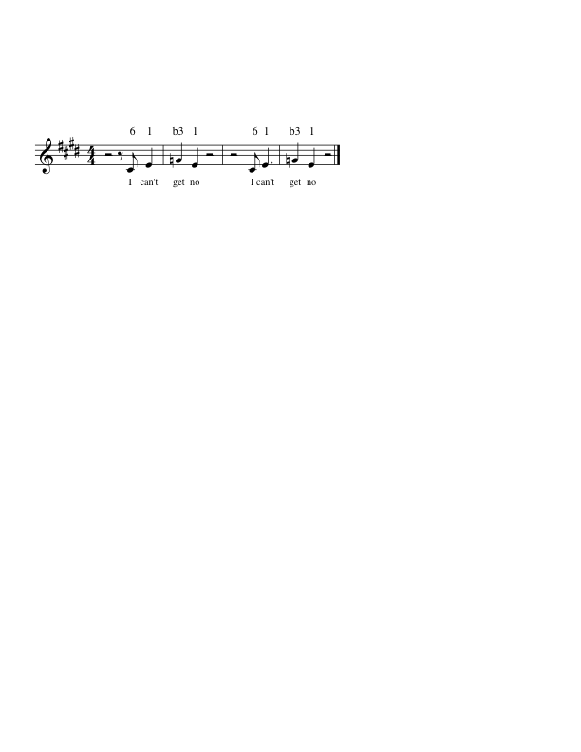
The pentatonic union scale is also reflected in numerous individual songs. Temperley & de Clercq (2013) speculated that this might reflect the influence of the blues.
Blues-based melodies are often pentatonic, and also often contain mixtures of major and minor pentatonic – e.g. combining 3 and b3, or using both b3 (from the minor) and 6 (from the major), as in the Rolling Stones’ “(I Can’t Get No) Satisfaction.”
major
pent.
1 2 b3 3 4 5 6 b7
minor
pent.

Slide 15
It seems clear that the influence of the blues on popular music has declined in recent decades – reflected in the declining use of blues-based harmonic progressions, for example.
So if the pentatonic union scale does reflect blues influence, we might expect it to become less prevalent – though it’s not clear what would take its place.
Adding in the new (2000s) songs, we examined the change in melodic scale-degree distributions over the decades.

Slide 16
We first split the data into two chronological periods, 1950-1979 and 1980-2009. The overall scale-degree distributions for the two periods:
The two periods seem similar overall – though there are some subtle differences that may be important (as we’ll see...)

Slide 17
We then split each chronological set into major and minor songs, by a very simple criterion: a song is major if 3 occurs more often than b3, minor otherwise.
This achieves very similar results to the K-means clustering method used before. On the 1950-2000 set, 175 out of the 194 melodies (90%) are categorized in the same way by these two methods.
(One song from the 2000s set, Radiohead’s “Everything in its Right Place,” uses neither 3 or b3, so it is not included in either category.)

Slide 18
We then looked at the scale-degree distributions for the major and minor groups in both historical periods.
For the major songs:
The distributions for the two periods are strikingly similar (yes, there are two lines here!).

Slide 19
For the minor set, the two periods also show quite similar distributions, but there is one very noticeable difference...

Slide 20
For the minor set, the two periods also show quite similar distributions, but there is one very noticeable difference..
In the earlier period, 6 > b6 (reflecting the “pentatonic union” scale, or perhaps Dorian mode). In the later period, b6 > 6 – more like Aeolian (natural minor).

Slide 21
Aeolian

Slide 22
Also, 3 is lower in the later period, and b3 is higher, so there is less “mixture” of b3 and 3 – again, more like pure Aeolian (and
again may represent declining influence of the blues).
Other small differences in the later period – the increase in 5 and decrease in 1 – are harder to interpret.

Slide 23
The most striking difference between the two periods is the shift in b6 and 6 in minor. But the number of songs in our corpus is fairly small: is this difference statistically significant?
One way of analyzing this is to represent each “minor” song with a single number, the “submediant ratio”:
submediant ratio = (count of 6) / (count of 6 + b6)
...the proportion of “submediant” notes that are 6 rather than b6. The data just shown suggests that this tends to decline over time.

Slide 24
Average submediant ratio in minor songs, by decade
...A pretty consistent pattern.

Slide 25
Submediant ratios in individual songs (minor songs only), shown chronologically
(Shaded markers indicate more than one data point.) Again a consistent pattern, and highly significant (r = –.74, p < .0001).

Slide 26
The relative decrease in 6 (and increase in b6) in minor seems plausibly related to declining blues influence. But what is replacing it? Natural minor?
What else would we expect to see if this is the case? Perhaps a shift from pentatonic melody to more diatonic melody.

Slide 27
Diatonic and pentatonic scales have different interval distributions (within the octave):
Diatonic scales contain half-steps (m2); pentatonic scales do not. If popular music has been getting more diatonic, we would expect to see more melodic half-steps.
Interval | Diatonic | Pentatonic
m2 | 2 | 0
M2 | 5 | 3
m3 | 4 | 2
M3 | 3 | 1
P4 | 6 | 4
TT | 1 | 0

Slide 28
Comparing melodic interval distributions between the two historical periods (1950-79 and 1980-2009):
Half-steps

Slide 29
Comparing melodic interval distributions between the two historical periods (1950-79 and 1980-2009):
Whole-steps become slightly less common in the later period. But half-steps are no more common (in fact, very slightly less so). So there is little evidence of a shift to diatonicism. (This is for ALL songs, major and minor – but just looking at minor songs yields similar results.)

Slide 30
Comparing melodic interval distributions between the two historical periods (1950-79 and 1980-2009):
More striking is the increase in repeated notes. Ascending and descending 4ths (+5, -5) also become more common.
Average interval size is practically unchanged (2.06 in the earlier period, 1.92 in the later period).

Slide 31
Schellenberg and van Scheve (2012) found increasing use of minor in recent popular music. In our corpus, the proportion of melodies in minor is virtually unchanged between the earlier and later periods...
Proportion of melodies in minor

Slide 32
Conclusions
Between the first and second thirty years of rock, the overall scale-degree distributions have been quite stable. The main change has been an increase in the frequency of b6 and a decrease in 6 in “minor” songs.
This may point to a move away from pentatonic, blues-based organization and a move towards natural minor. However, the distribution of intervals does not reflect this.

Slide 33
One might wonder whether the results are due to the particular
set of songs that the corpus happens to include.
One might ask, indeed, what the corpus is supposed to represent. (Those polled for the earlier list were asked to name the greatest songs of the “rock and roll era”; those polled for the later list were asked to name the “best songs” of the 2000s.)
Perhaps all one can say is that the corpus represents a fairly broad spectrum of late 20th-century / early 21st-century popular music.

Slide 34
Further questions about historical change in popular music
- Do the harmonic analyses of recent songs reflect an analogous shift towards natural minor? (We have just finished the harmonic analyses of the 2000s songs and have not yet done much with them.)
- Does the melodic data reflect a rise or fall in complexity over time? It has been suggested that popular music has gotten simpler (Serra et al., 2011).
- Does the melodic data (in combination with the harmonic data) reflect a shift in the coordination between melody and harmony? A degree of independence between melody and harmony is characteristic of earlier rock – again, perhaps, reflecting blues influence (Temperley, 2007).

Slide 35
Thank you for your attention!

Slide 36
References
de Clercq, T. 2014. “Typical Chords in Typical Song Sections: How Harmony and Form Interact in a Corpus of Rock Music.” Eighth European Music Analysis Conference (EuroMAC).
de Clercq, T., & Temperley, D. 2011. "A Corpus Analysis of Rock Harmony." Popular Music 30, 47-70.
Schellenberg, G., & van Scheve, C. 2012. “Emotional cues in American popular music: Five decades of the Top 40.” Psychology of Aesthetics, Creativity, and the Arts, 6, 196–203.
Serrà, J., Corral, A., Boguna, A., Haro, M., & Arcos, J. 2012. “Measuring the Evolution of Contemporary Western Popular Music.” Scientific Reports 2, article 521.
Temperley, D. 2007. "The Melodic-Harmonic 'Divorce' in Rock." Popular Music 26 #2, 323-342.
Temperley, D. 2011. "The Cadential IV in Rock." Music Theory Online 17.1.
Temperley, D., & de Clercq, T. 2013. “Statistical Analysis of Harmony and Melody in Rock Music.” Journal of New Music Research 42, 187-204.

