Slide 1


A corpus study of rock music:
The RS200 annotations as an expert ground-truth data set
Trevor de Clercq
Assistant Professor, Ithaca College
NYU, Music and Audio Research Lab
May 10, 2013

Slide 2
What is a corpus study?
A corpus is a body of data
• the text of some collection of books (linguistics)
• the chords in a collection of musical compositions
• the notes in the melodies of a collection of songs
Research method
• encode corpus
• search for patterns (with a computer, typically)
• offers some level of objectivity in analysis

Slide 3
How can we do corpus-based music research?
Types of encodings
• humdrum (David Huron, Ohio State)
• music21 & python (Michael Cuthbert, MIT)
• custom-based text encoding
Types of research questions
• Are dissonant harmonies more common in middle sections?
• Do performers slow down with increased harmonic motion?
• Do melodies more often fall or rise at the end of phrases?

Slide 4

A collaborative project with David Temperley (Eastman)
Our goal:
To get statistical evidence about patterns in rock music

Slide 5
What is rock music? Here, a broad definition.
Rolling Stone magazine “500 Greatest Songs of All Time” (2004)
(the RS500)
1: “Like a Rolling Stone” (Bob Dylan, 1965)
2: “Satisfaction” (The Rolling Stones, 1965)
3: “Imagine” (John Lennon, 1971)
4: “What’s Going On” (Marvin Gaye, 1971)
5: “Respect” (Aretha Franklin, 1967)
....
30: “I Walk The Line” (Johnny Cash, 1956)
44: “Georgia On My Mind” (Ray Charles, 1960)
256: “Paranoid Android” (Radiohead, 1997)
346: “California Love” (Dr. Dre and 2Pac, 1996)
399: “Enter Sandman” (Metallica, 1991)

Slide 6
Our work so far
• de Clercq, Trevor and David Temperley. (2011). “A corpus analysis of rock harmony.” Popular Music 30/1: 47-70.
• 100 song set: RS5x20
= Top 20 songs from each decade of RS500, ‘50s – ’90s
• Temperley, David and Trevor de Clercq. (TBD). “Statistical Analysis of Harmony and Melody in Rock Music.” Journal of New Music Research.
• 200 song set: RS200
= RS5x20 + next highest 100 songs (any era)
• harmonic analyses, melodic transcriptions, timing data online: http://theory.esm.rochester.edu/rock_corpus/

Slide 7
An expert ground-truth data set
• Data set for music information retrieval projects
• audio chord recognition
• measure recognition
• automated melodic transcription
• Other extant data sets
• McGill Billboard (Hot 100) project
• 649 songs spanning 1958-1991
• University of London, Center for Digital Music corpora
• Beatles, Queen, and Carole King catalogs
• harmonic and timing information only

Slide 8
Overview of talk
Harmonic analyses
Melodic transcriptions
Timing data

Slide 9
Harmonic Analyses
Harmony in certain styles displays particular patterns.
• Common-practice music (e.g., Bach, Beethoven, Brahms)
• Pre-dominants (ii, IV) typically move to Dominants (V, viiº)
• Dominants (V, viiº) typically move to Tonics (I)
• Phrase model: T – (PD) – D – T
• e.g., String Quartet #51, menuetto (F. J. Haydn, 1790)
• Similar principles are found in jazz music (ii – V – I)

Slide 10
Common-practice harmonic patterns can be found in rock
• “Twist and Shout” (The Beatles, 1963)
• I – IV – V
Other songs go against common-practice harmonic patterns
• “Hungry Like the Wolf” (Duran Duran, 1982)
• I – V – IV

Slide 11
Timbre and texture strongly influence our perception of styles
.... but harmony (and other factors) play roles
Ex: Vitamin String Quartet, “Hungry Like the Wolf”

Slide 12
What (if any) are organizational principles of harmony in rock?
• Music theorists give conflicting views
  • Walter Everett, 2004:
  "Making Sense of Rock's Tonal Systems". Music Theory Online. 10/4 (December).
  => rock as common-practice system
  • Ken Stephenson, 2002
  What to Listen for in Rock: A Stylistic Analysis. New Haven: Yale University Press.
  => rock as opposite to common-practice system
  • Allan Moore, 2001
  Rock: The Primary Text: Developing a musicology of rock. Aldershot, UK: Ashgate.
  => rock as a modal system

Slide 13
How to encode the corpus?
Songs individually analyzed by both authors
Recursive notational system
“Da Doo Ron Ron” (The Crystals, 1963)
A: I | IV | V | I |
In: I |*4
Vr: $A*2 I | IV | I | V | $A I |*2
So: $A*2
Ou: $A*4
S: [Eb] [12/8] $In $Vr*2 $So $Vr $Ou

Slide 14
Recursive computer program (expand6.c)
“expands” harmonic analyses
Expanded version of “Da Doo Ron Ron” (The Crystals, 1963)
I | | | | | IV | V | I | | IV | V | I | ....
... and also creates a CHORD LIST
start end RN ChrRoot DiaRoot Key AbsRoot
0.00 5.00 I 0 1 3 3
5.00 6.00 IV 5 4 3 8
6.00 7.00 V 7 5 3 10
7.00 9.00 I 0 1 3 3
9.00 10.00 IV 5 4 3 8
(and so on....)

Slide 15
% Bohemian Rhapsody
A: bVI V #IV V |
B: vi | ii . ii42 viih7 |
C: IV64 I . . |
In1: [Bb] vi7 | V7/V | V7 | I | vi | [Eb] V7 | I | ii/V | V/V | $A*2 [Bb] IV I6 | viix42/V V64 | |
Vr1a: [Bb] I |*3 vi | ii | ii V | I | vi | ii | viih7 . . ii64 |
Vr1b: [Eb] I . . V65 | $B V | I V6 |
Vr1b1: [Eb] $Vr1b vi iv | I | [2/4] |
Vr1b2: [Eb] $Vr1b $B V | I V6 | $B bVII . bVII/bVII vi/bVII |
Vr1: $Vr1a $Vr1b1
Vr2: $Vr1a $Vr1b2
Br1: [A] I | | $C*2 IV64 I IV64 I | . . IV64 I |
Br2: [A] III64 V/III | bIII64 V | I |*3 [2/4] V |
Br3: [Eb] I | $A*2 $C*2 IV I6 | V/V V | IV I6 viix42/V ii7 | $A*2
Br4: [Eb] I V I . | V . . I | . V I V | . . . I | . V I V | . . . I | V . . I | V | bIII |
Br5: [Eb] bVI V/VII VII V/bIII | bIII V I . | V . . I | IV I V . | I IV64 | V/iii iii | V |*4
Rf1: [Eb] [12/8] I |*3 V/V | V | . I | V | [6/8] . bVII | [12/8] V | . I | IV | ii | V | ii | V | ii V | ii V |
Rf2: [Eb] [12/8] I |*3 V/V | bIII IV #IV | bVI | IV | V |*3
Ln: [Eb] [4/4] I V6 | vi . V6/vi vi | V6/vi vi V I | V/iii iii | IV I |
Ref: [Eb] vi iii | vi iii | vi iv | V11 | I IV64 | I viix43/V | V6 iv6/II | [F] V | . I | | |
Pt1: $In1 $Vr1 $Vr2
Pt2: $Br1 $Br2 $Br3 $Br4 $Br5 $Rf1 $Rf2
Pt3: [4/4] $Ln $Ref
S: [Eb] $Pt1 $Pt2 $Pt3

Slide 16
Statistics show that harmonic analysis is (somewhat) subjective
• agreement on chromatic relative root (e.g. I vs. IV): 92.4 %
• agreement on absolute root (e.g. A vs. D): 94.4 %
(Rolling Stones, “Satisfaction”)
• agreement on key (or pitch center): 97.3 %
(Lynyrd Skynyrd, “Sweet Home Alabama”)
• # of songs with 100% agreement: 39
• # of songs where agreement was between 90-99%: 39
(2011 paper reports averages from DT and TdC)

Slide 17
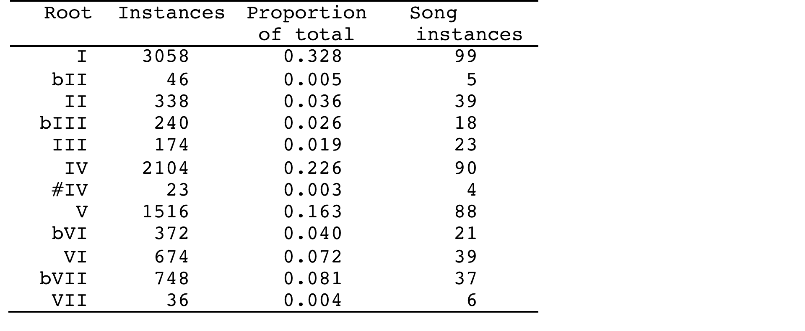
Statistics show information on harmonic palette
(zeroth-order probabilities)
Top five chords: I, IV, V, bVII, VI. Very different from common-practice music, especially IV>V and high freq. of bVII.

Slide 18
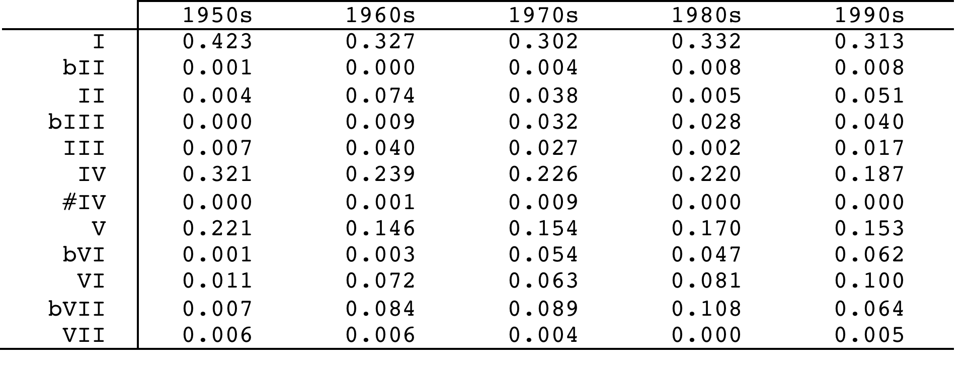
Statistics show information on harmonic palette over time
(zeroth-order probabilities)

Slide 19
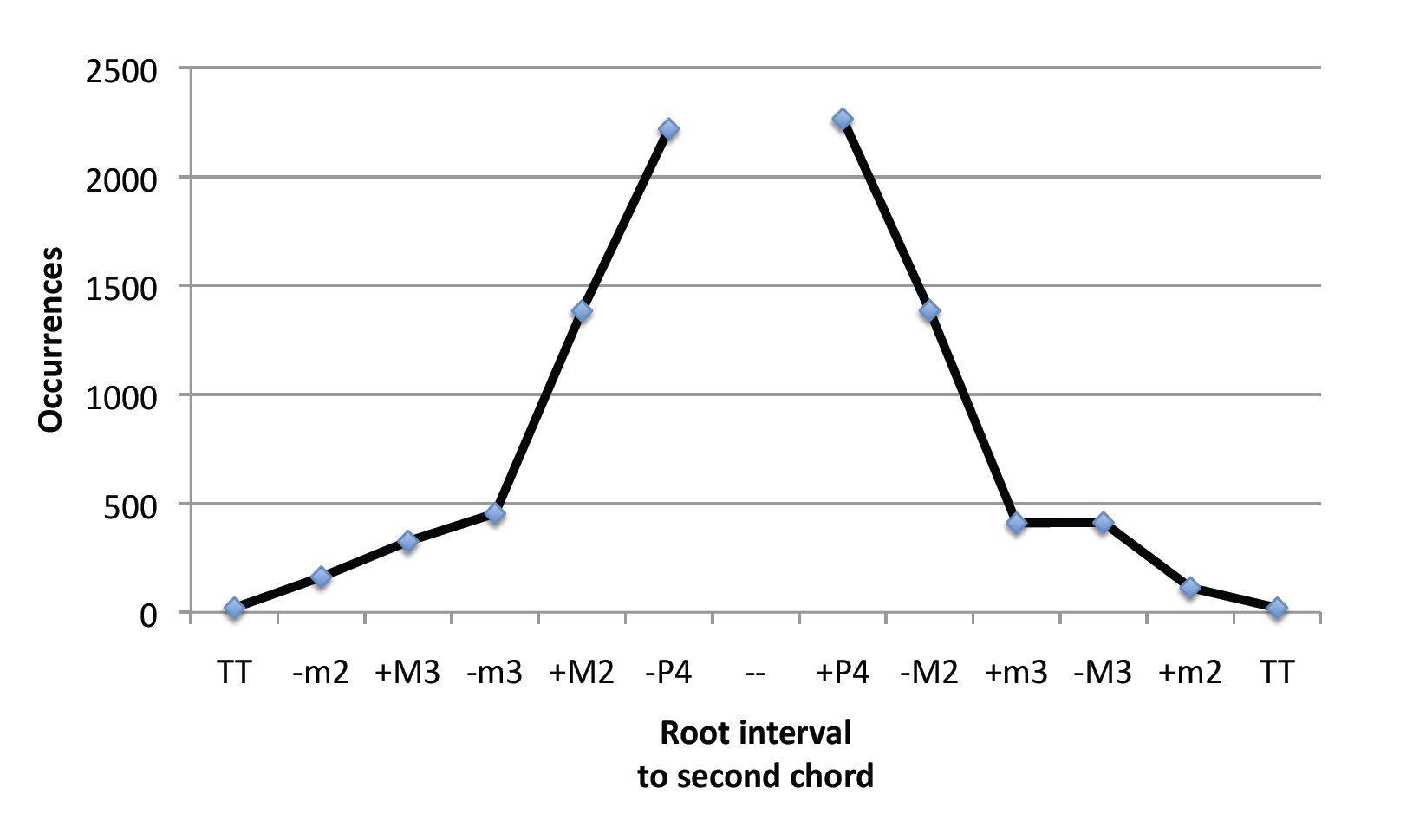
Root motions on a “line of fifths”

Slide 20
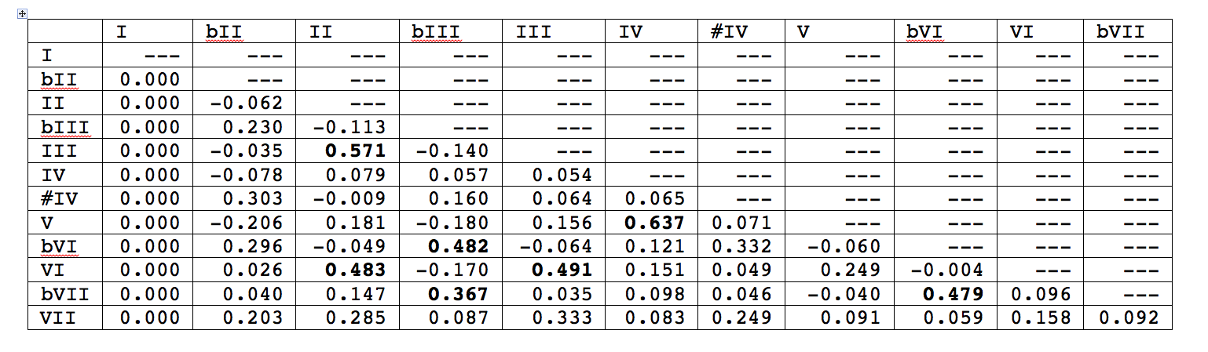
Chord vectors (cont’d)
Correlations above 0.350 are circled.

Slide 21
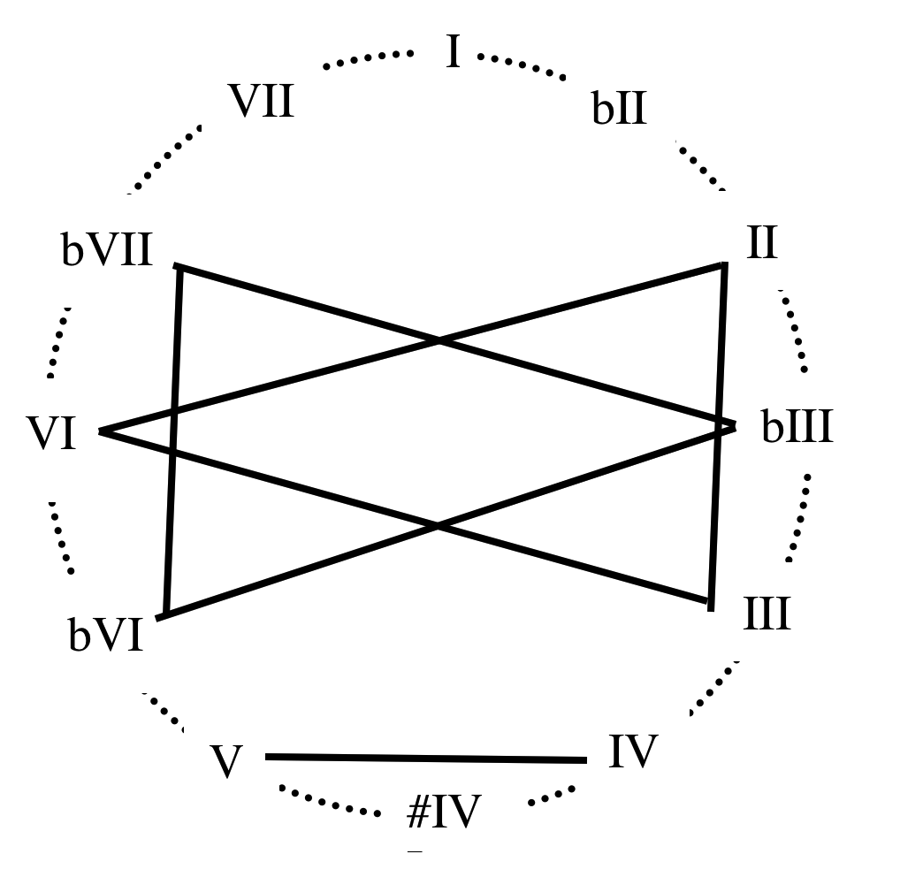
Chord pairs with high correlations (above 0.350)
• IV and V
• VI, II, and III
• bIII, bVI, and bVII
Correlations suggest some sort of modal harmonic organization.

Slide 22
II. Melodic transcriptions
Notation
We devised a simple notation for transcribing the melodies. For “Hey Jude”, for example, here is a transcription of the first main section:
[F] [4/4] [OCT=4] . . . 5 | 3. .. .3 56 |
v2. .. .. 23 | 4. ^1. .1 75 |
6.54 3... _ ..5. | 6.6. ..6. 21.7 .16. | 5. .. v12 36 | 5. .5 43 .7 | 1 . . 5 |

Slide 23
Problems
We found the task to be quite difficult—a good deal more difficult than the harmonic analysis.
- It’s not always obvious which vocal line is the “melody” (we’ll see an example in a minute)
- Some notes are indeterminate as to pitch – “blue notes” that fall between two pitches, or notes with gliding pitch, or notes that are quasi-spoken
- Some notes are indeterminate as to rhythm (or seem to require very complex rhythmic notation)
(These problems of transcription are not unique to rock but occur with many kinds of music.)

Slide 24
Problems
Here’s one complex example – a phrase from Otis Redding’s “I’ve Been Loving You Too Long” (as TdC transcribed it):
• There’s a slight scoop up to the first long note, and then a significant glide downwards at the end of it; should these be notated or not?
• Should the rhythm of the second phrase be notated literally (as TdC does) or is it just an expressively stretched rendition of a simpler rhythm (e.g., ee | e e e q. “and you want to be free”)?

Slide 25
% Bohemian Rhapsody
[Bb] [OCT=4] 55 55 .5 .. | #4.#4. 5.#4. 32.. _ | 44 44 .v5 55 | ^33 43 21 .. |
33 33 .. .3 | [Eb] 7.7. 1.12 ..v5. ..^3. | |
3.3. 3.23 ..23 _ | 2.2. 3.2. 163. 4.5. | 11 7. #6#6 7. | 11 7. #6#6 7. |
[Bb] 66 66 5. 1. | v#4#4 #45 5v5 57 | 2. .. .. 71 | 1 | |
3..23... __ __ ....1... | 2.33 _ _ ..33 | 45.4 .3.2 _ 2.3. | 45.4 .3.2 _ _ |
3..23... __ __ 3...5... | 7..6 6... _ ..6. | 1.1. 1.1. 1..6 43.. | .22. _ _ _ |
[Eb] ^3..23... __ __ 2...3.4. | 3... _ _ ..33 | 4..3 3.2. 2... ...v5 | 5.^2. 2.33 ..4. 4.5. |
433. ..23 5... ..23 | 1... ..55 b6b7.b6 b7.5. | 5 | [2/4] . | [4/4] [Bb] . | |
3...23.. __ __ ....1... | 2.33 _ _ ..3. | 45.4 .3.2 _ 23.. | 454. 3.32 _ _ |
3..23... ....2.1. 2.3..... ....5... | 7..6 6... _ ..56 | 1.1. 1.1. 1..6 43.. | .22. _ _ _ |
[Eb] ^323. _ _ 2.34 | 3 | 4..3 32.2 _ ...v5 | 5.^2. 2.3. 344. 4.54 |
.3.. _ _ _ | R*7 | [A] R*2 |
4. 33 #2#2 33 | 44 33 #2. 55 | 1. 55 1. 55 | #4#4 5. 6. 5. |
#5#5 #5#5 6. 6. | b7b7 b7b7 7. 7. | 1. ^55 b65 v11 | b21 ^55 b65 v11 |
b21 ^55 b65 4b3 | [2/4] 2vb2 ^b2b2 |
[4/4] [Eb] 53 .1 .6 5. | b6. 55 #4. 5. | b6. 55 #4. 5. | ^1. 11 1. 1. |
11 1. 11 1. | 6. 61 5. 55 | #4. #4#4 5. .. | |
vb6b6 5. #4#4 5. | b6b6 55 #4. 5. | 1. 5. ^1. .v2 | 23 43 2^1 11 |
.. v5. 1. 5^2 | 23 43 2^1 11 | .. v5. 1. 5^2 | 23 43 2^1 11 |
v23 43 2^1 11 | v23 43 v55 11 | b7^5 .b3 .b2 b7. | 1#1b34 |
5. 7. 1v5 55 | 65 55 65 ^33 | 43 21 2. v5. | ^1. .1 1. 11 |
77 77 3. 3. | v4. .3 2. 3. | 6. .5 4. 3. | ^5 | |
[12/8] . | R*3 |
..v4 .4. 3.3 .3. | 2.2 .2. 1.1 1.. | 7.1 2.. - - | [6/8] . |
[12/8] ..4 .4. 3.3 .3. | 2.2 .2. 1.1 .1. | 4.5 6.. ..4 - | 3.4 - - - |
3.2 2.. ..3 - | ..4 .4. 4.4 .3. | 3.2 2.. ..3 - | 1.1 112 - - |
1.1 11. 2.1 .7. | 1.5 - - - | R*9 |
[4/4] ^3.2. | 1.71 | 71.. | R*2 |
4.3. 1v3.5 .5.. _ | ^32.1 .7.. 5... _ | ^3.1. 23.1 .b6.. _ |
^3.2. 21.1 .6.. ...7 | 1 | R*2 |
[F] R*2 | 44 33 b3. ^1. | |

Slide 26
Other problems
Eight songs on the list were judged to have no melody at all—either rap / hip hop songs, or those in which the pitches of the melody were largely indeterminate. This left a corpus of 192 songs.

Slide 27

Level of agreement
We both analyzed 25 songs so as to examine the level of agreement between us.
Melodic transcription duties for the RS200 were divided between TdC and DT. (Each author transcribed the melody for 100 songs, randomly assigned.)

Slide 28
ANALYSES OF THE DATA
With our melodic transcriptions, we can answer questions about the types of pitch collections (i.e., “scales”) used in rock music.
• What is the overall distribution of scale-degrees in the data, i.e., pitch-classes in relation to the tonic?
• Does rock have a consistent “scale”? Can we distinguish diatonic
from chromatic scale-degrees, as we do in classical music?
• Do rock songs group into natural categories with regard to their
scalar organization – analogous to classical major and minor?

Slide 29
There’s been much speculation about these questions. With regard to scales, a variety of frameworks have been applied to rock:
- Common-practice major and minor scales
- Pentatonic scales
- Diatonic modes (Mixolydian, etc.)
- Blues scales
- Scales arising from harmonic progressions
...but there’s little consensus on this issue, and little hard evidence has been put forth.

Slide 30
Scale-degree distribution for classical music (gathered from a corpus of excerpts from the Kostka-Payne theory textbook, grouping major and minor together)
_ _ _ _ _ _ _ (Major-scale degrees)
The seven major degrees are most common (partly because there are more major than minor pieces). Next are the minor degrees—b3, b6, and b7. (7 is much more common than b7.) b2 and #4 (“chromatic” degrees) are least common.

Slide 31
Comparing the scale-degree distribution from our rock harmonic analyses (counting each pitch-class once for every chord that it occurs in), we see a fairly similar pattern...
As in classical music, b2 and #4 are least common. 7 is still more
common than b7, but the difference is smaller. The 6 > b6 difference
is greatly increased.

Slide 32
Now we add in the melodic rock data (blue). (We count each note separately, not weighted for duration.)
Similar to the harmonic rock data and classical data. But now, b7 > 7, by a considerable margin. Note also the very low value for b6 (but still higher than b2 and #4).

Slide 33
Scales in Rock
To what extent do rock songs reflect conventional scales—modal, pentatonic, etc.?
As a first approach, we can represent each song with a binary 12-valued vector, showing which scale-degrees occur in the song and which ones do not. A song that uses only the major scale would therefore have this vector:
1 0 1 0 1 1 0 1 0 1 0 1
(1 b2 2 b3 3 4 #4 5 b6 6 b7 7)

Slide 34
The most common vectors, with their frequency of occurrence (out of 192 songs):
Num occ.
1. 101011010101 29 (major)
2. 101011010100 17 (“diatonic
hexachord”)
3. 101111010110 10 (bluesy?)
4. 101111010100 7 (bluesy?)
5. 101010010100 7 (major pentatonic)
Not terribly revealing because it does not consider how often each scale-degree is used in a song. (Note also that these 5 scales account for only 70 songs, less than 40% of the total.)

Slide 35
A second approach: Take a song and a scale, and consider whether the degrees of the scale are the most frequently occurring scale-degrees in the song. If so, we declare that song to “match” that scale. (So this allows some “chromaticism” in relation to the scale.)
We can then consider how many songs match various scales.

Slide 36
Examining some scales that are of particular interest:
Num matches
101011010101 42 (Major)
101011010110 12 (Mixolydian)
101101010110 9 (Dorian)
101101011010 6 (Aeolian or
“natural minor”)
101010010100 50 (major pent)
100101010010 21 (minor pent)
This data does not give much support to the idea that rock is largely “modal”. There are relatively few songs in which the most frequent scale-degrees form a diatonic mode (other than major). There’s some evidence of pentatonicism, though this matching method favors scales with fewer notes.

Slide 37
Clustering
Can we simplify this picture in any way? If we were to “cluster” rock songs into a small number of categories as to their scalar content, what would the categories look like?
A “hill-climbing” approach
Randomly assign the songs into a certain number of categories.
For each category, construct an aggregate scale-degree distribution.
Within each category, measure the match of each song to the category’s distribution.
Randomly shift one song from one category to the other, and repeat the process. If this change improves the quality of the clustering, keep it; if not, don’t.
Iterate this process many times.

Slide 38
The results, sorting the songs into three categories:
Category 1 (blue, 41 songs) looks like major pentatonic (1, 2, 3, 5 and 6 are highest)
Category 2 (red, 73 songs) looks like major diatonic
(or diatonic hexachord)
Category 3 (green, 78 songs)—somewhat like a “minor” category

Slide 39
Category 3—the “minor” category—is of particular interest:
The minor pentatonic degrees are most frequent, followed closely by 2. But both 3 and 6 are quite common. This also resembles the “blues” scale, though this is defined in different ways (#4 is often included in the blues scale). It is also the union of the major and minor pentatonic scales.
We could also think about this category as a collection that avoids half-steps around ^1 (no ^b2 or ^7) and ^5 (no ^#4 or ^b6).

Slide 40
Many of the songs in this “minor” category are
1) early (1950s) rock’n’roll songs
2) songs by “hard rock” or blues-based bands
3) soul songs such as Aretha Franklin’s “Respect.”
The Rolling Stones, “Satisfaction”

Slide 41
III. Timing data
• Measure locations input using Sonic Visualiser software:
http://www.sonicvisualiser.org
• Measure locations done by ear, then adjusted by eye and ear
(delay compensation required)
• Measure locations correspond with measure numbers, measure lengths, and time signatures in the harmonic analyses and melodic transcriptions
• Time “0.000” corresponds to beginning of audio file

Slide 42
Timing data structure
Column 1: time (in seconds) from start of audio file
Column 2: bar number (with “0” being the first bar)
every_breath_you_take.tim:
0.83199546473 0
2.86628117873 1
4.92179138273 2
6.97077097473 3
9.00097505573 4
11.0556689337 5
13.1050340127 6
15.1487301587 7
17.1963492057 8
19.2109523807 9
21.2623809517 10
23.3233333327 11
25.3696825387 12
....

Slide 43
Chord lists can have timings added
(add-timings.pl)
“every_breath_you_take_tdc.har”
as processed through expand6.c and add-timings.pl
AbsTime RelTime RN Root & Key
0.832 0.00 I 0 1 9 9
4.922 2.00 vi 9 6 9 6
9.001 4.00 IV 5 4 9 2
11.056 5.00 V 7 5 9 4
13.105 6.00 I 0 1 9 9
21.262 10.00 vi 9 6 9 6
25.370 12.00 IV 5 4 9 2
27.422 13.00 V 7 5 9 4
29.467 14.00 vi 9 6 9 6
33.555 16.00 I 0 1 9 9

Slide 44
Note lists can have timings added
(add-timings.pl)
“every_breath_you_take_tdc.mel”, as processed through process-mel5.pl and add-timings.pl
AbsTime RelTime AbsNote ScaleDeg
15.661 7.25 61 4
15.917 7.38 62 5
16.173 7.50 61 4
16.684 7.75 59 2
16.940 7.88 57 0
17.448 8.12 57 0
19.724 9.25 61 4
19.980 9.38 62 5
20.237 9.50 61 4
20.750 9.75 59 2
21.006 9.88 57 0
21.262 10.00 57 0

Slide 45
Download information for audio files of RS200 corpus
http://www.midside.com/rock_corpus/
user: rscorpus
pass: nyu510!!m2st3rs$$
Two versions are available:
128 kbps constant bit-rate MP3 files (a single zipped folder of ~ 750 MB)
Original CD-quality files in AIF format (~ 8 GB, divided into four zipped folders of 50 songs (each ~ 2 GB)
Password to unlock zip files is “audiov20”

